Slide 1
Suite Service Thought Leadership Challenge Aug 15, 2017

Slide 2
Agenda
Introduction
Business Case
User Research
Architecture
Demo
Next Steps
Notes:
Presenter: Adam

Slide 3





Meet the Team
Laura Kerr
Ram Ramkumar
Maddie Stigler
Scott Murray
Chris Eklund

Slide 4

Suite Service: Re-inventing the Hotel Service Desk
Submit service desk requests
Order room service
Inquire about amenity location and hours
Extend a hotel reservation
Checkout
Notes:
We chose to create an Alexa skill called Suite Service, which is a hotel-based service that takes a new approach to the process of requesting, receiving, and monitoring hotel service requests. The overall idea is that this skill would replace the manual process of calling down to the front desk whenever you have a need.
In its current state, this process is very tedious and cumbersome – guests have to call down to the front desk, hope that an employee is available and picks up, and manually submit their request. On the employee side, there is no easy way of relaying requests to the appropriate employee, keeping track of active requests, and keeping the guests up to date on the status of their requests. Overall, it is a very manual process and things can get lost easily. In addition, it’s a large burden on the employees and a fairly unpleasant experience for the guests.
We saw an opportunity here to build an alexa skill that would automate the process of and increase the efficiency of requesting, receiving, and monitoring hotel service requests

Slide 5
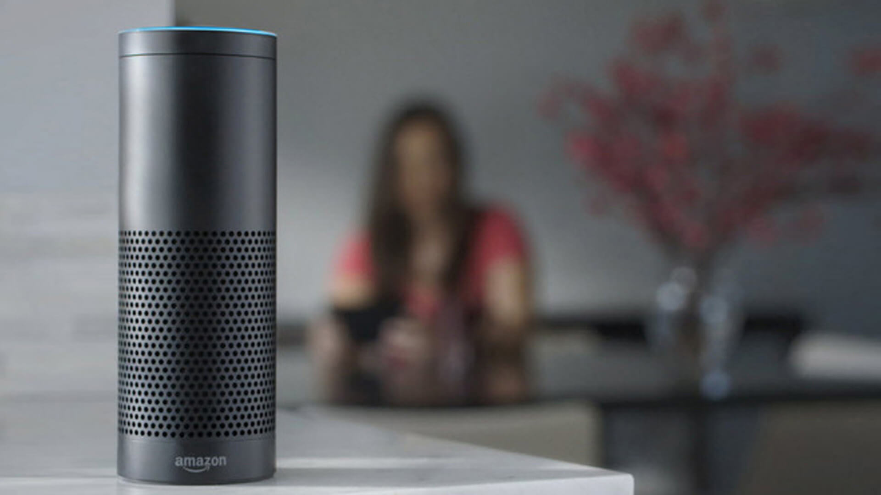
“Alexa, tell Suite Service that I forgot a toothbrush”
“No problem,
we’ll send a toothbrush to your room right away”
Notes:
We all know what its like when you're staying at a hotel – there's always something that you forget to pack, something that you run out of, or something that you simply want to know more about​
​
Our main focus throughout this project was to keep the users in mind – how can we make this skill create a really simple, easy, and intuitive way of filling a user need ​
​
How easy would it be to simply say “Alexa, tell Suite service that I forgot a toothbrush”. What’s really unique about this skill is that it is more than just a call and response app – it is a skill that triggers a fully functioning system and architecture, all by simple voice recognition, and it can be expanded greatly to include an endless list of additional functionality
​

Slide 6
Key Features
Hotel guests can quickly and easily:
Hotel employees can efficiently:
Submit service desk requests
Order room service
Inquire about amenity location and hours
Extend a hotel reservation
Checkout
Register guests to a unique Alexa device
Manage all incoming / outgoing requests
Alert hotel guests about various requests
Notes:
In its current state…

Slide 7
Business Case

Slide 8
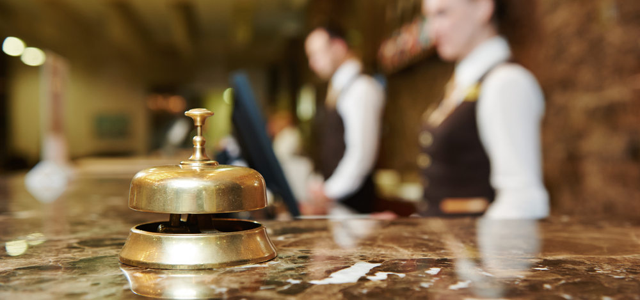
Understanding of Need

Slide 9






Value-Add Opportunities
Current State
Suite Service
Manual request process
Slow and tedious user experience
Lack of data management
Inefficient use of employee resources
Outdated technology
Requires costly employee resources
Automated request process
Delightful user experience
Data storage and user insights
Removal of the “middle man”
Cutting edge technology
Cost-effective technology stack

Slide 10
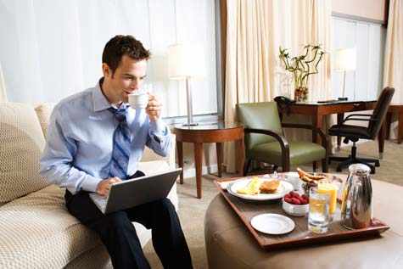

Personas
CapTech Employee
CapTech Interns 2017
Traveling for Business
Traveling for Pleasure
CapTech consultant
Travels 3 days a week
Mid-20s, comfortable with technology
Limited budget and time constraints
Motivated by ease-of-use and convenience
Notes:
We also kept in mind the classic traveler dichotomy – either traveling for business (captech employee) or traveling for pleasure (captech interns, family vacation, college spring break)

Slide 11
User Research
Notes:
Presenter: Adam

Slide 12






Prioritized Key Features based on Client Interviews
Interviewed prevalent Richmond hotels
Determined most popular service desk requests
Restaurant Recommendations & Hours​ | 6​
Toiletries​ | 5​
Towels/Sheets​ | 4​
Facility Information​ | 4​
Wake-up Call​ | 4​
Wifi​ | 3​
Things to do​ | 2​
Shuttle Info​ | 2​
Extra Bed/rollaway/crib​ | 1​
Room Upgrade/Change​ | 1​
Room Service​ | 1​
Notes:
Interviewed across a wide range of hotel star ratings → Designed Suite Service to be applicable to any type of hotel client
Point out that features that we didn’t choose are accounted for by other Alexa skills – Alexa provides business value outside of just Suite Service
Explanation as to why room service was at the bottom but we did it anyways??

Slide 13
Design Process
Iterative Process
Allowed the team to become familiar with designing for voice vs UI and for adding complexity and surprises as we went
Imagine
Practice
Build
Notes:
Imagine – establish the purpose and user stories(from user research); create a dialog sketch (script) for the happy paths; draw out user flow
Practice – read scripts; refine for how humans speak; add for exceptions
Build – code your scripts; test your interactions; refine and add utterances
Allowed the team to become familiar with designing for voice vs UI; created content needed for building; allowed for adding complexity and surprises as we went

Slide 14
Architecture
Notes:
Presenter: Nathan

Slide 15




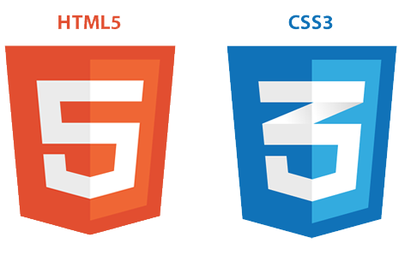
Tech Stack

Slide 16
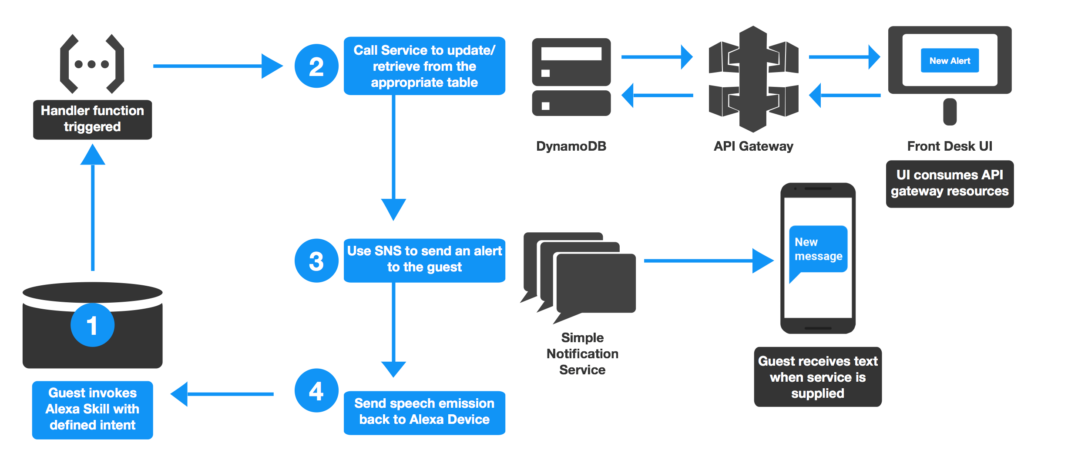
Architecture

Slide 17
Demo

Slide 18




B E F O R E P I C K I N G U P T H E P H O N E … C O N S I D E R A S K I N G A L E X A !
S U I T E S E R V I C E
y o u r f r o n t d e s k a s s i s t a n t
General Requests
Try...
Forgot a toothbrush?
“Alexa, ask SUITE SERVICE to
send me three towels”
Need more towels?
Room Service
Try...
Hungry for a late night snack?
“Alexa, ask SUITE SERVICE to
order a hamburger”
Need a quick breakfast?
Amenity location & hours
Try...
Need to know the fitness center hours?
“Alexa, ask SUITE SERVICE to
tell me if the fitness center is open”
Can’t find the ice maker?

Slide 19
Next Steps

Slide 20
Next Steps
Fully integrating into existing infrastructure and data systems
Improving on current functionality
Incorporating Data Analysis / Machine Learning to provide predictive data and customized responses
Notes:
Improving on current functionality: (We realize that our skill doesn’t cover everything in its current state)
Family functionality
Checkout email
Cancel intent
Alexa calling you if you’re having trouble
Fully integrating into existing infrastructure and data systems
Incorporating data analysis/machine learning to customize responses based on:
Most common requests
User’s past requests
When is the ___ most crowded
What is the most popular

Slide 21

Future State Enhancements
Real-time data-driven service requests
In-database analytics (aggregation, counts, numerical operations)
Expanded architecture to accommodate supporting information (orders, service access frequency, wait times, etc.)
BI applications for guest insights
"Suite Service, what's the most popular breakfast item?"
"Suite Service, when is the gym the most crowded?"
"Suite Service, what kind of salads are on the menu?"

Slide 22
Appendix

Slide 23
Github
https://github.com/mgstigler/SuiteService.git
If you would like to access our skill to test it with your own device, send us your email and we can add you to our Developer Portal

Slide 24
Suite Service Architecture Flows

Slide 25



Guest Registration
POST
2. Update the room with guest information
1. Assign guest a room
/room
createRoom
PUT
Guests
{ “AlexaId” : “string”,
“RoomNumber” : “string”,
“Fname” : “string”,
“Lname” : “string”,
“PhoneNumber” : “string”
}
updateRoom
Key:
AWS Lambda
Amazon DynamoDB
GET
AWS API Gateway
getRoom

Slide 26
Alerts
Alerts
{
“Message” : “string”,
“Service”: “string”,
“Fname”: “string”,
“Lname”: “string”,
“PhoneNumber”:”string”,
“RoomNumber”: “string”,
“Timestamp” : “DateObj”,
“isActive”: bool
}
2. Handler takes found utterance and posts it to the Alerts table
/alerts
3. Alert shows up on UI
1. Guest asks for a service
GET
handler
POST
5. Lambda sends text to Guest with alert using SNS
Key:
4. Alert is labeled inactive after click and sent to lambda
AWS Lambda
Amazon DynamoDB
AWS API Gateway
alertService

Slide 27
Intent Flows

Slide 28
Service Intent
3. Confirm utterance is a service
2. Utterance triggers lambda
ServiceLookup
1. User asks for a service
handler
Intent returns:
One service
Multiple services
Alert for service
6. Responds to user
4. Returns confirmation to lambda
5. Trigger Alerts

Slide 29
Food Service Intent
FoodService
{
“Index”: “number”,
“FoodItem”: “string”,
“Menu”: “Array”,
“Price”: “number”,
“Rating”:”number”,
“Pairing”: “string”
}
2. Utterance triggers lambda
3. Food information grabbed from Food Service table
1. User asks for food
Intent returns:
Food information
Card with food
Food for particular hour of day
handler
4. Returns information
6. Responds to user
5. Parse information for appropriate response

Slide 30
Menu Intent
FoodService
{
“Index”: “number”,
“FoodItem”: “string”,
“Menu”: “Array”,
“Price”: “number”,
“Rating”:”number”,
“Pairing”: “string”
}
2. Utterance triggers lambda
1. User asks for a menu
3. Menu information grabbed from Food Service table
handler
Intent returns:
Menu for time of day
Food included in menu
4. Returns information
6. Responds to user
5. Parse information for appropriate response

Slide 31
Amenity Intent
Amenities
{
“Index”: “number”,
“Amenity”: “string”,
“ClosingHour”: “number”,
“OpeningHour”: “number”,
“Location”:”string”
}
1. User asks for amenity information
2. Utterance triggers lambda
3. Amenity information grabbed from Food Service table
handler
Intent returns:
Amenity hours
Hours remaining for use
Card with location
4. Returns information
6. Responds to user
5. Parse information for appropriate response

Slide 32
Order Room Service
Submit Service Desk Request
Request General Hotel Information (TBD)
Potential User
Sub Goals
Hear menu options
Order a specific item on the menu
Receive recommendations for common food pairings/additions ( ex: hamburger – fries, pancakes - OJ)
Specify a delivery time
Confirm order
Submit common service desk request:
Additional Towels
Toothbrush
Shampoo/conditioner
Additional pillows / blankets
Etc …
Set alarm (“wake up call”)
Reminder of continental breakfast times
Extend stay / edit reservation
Ex:
Check out time
Location of ice maker / vending machine
Time of continental breakfast
Etc..
Alexa Output
Confirmation of order
Total price
ETA of delivery
Notification of “delivery on the way”
Confirmation of request
If delivery:
ETA of delivery
Notification of “delivery on the way”
If reservation edits:
Pricing changes
Request for user acceptance of changes
Provide information requested
…..
Data Requirements (quick brainstorm)
Room number, user ID
Items on menu
Prices of items on menu
Common food pairings
Categories of food
Room number
User account
Employee on staff
Employee contact info
Room number, user ID
If delivery:
ID of item requested
Employee responsible for request
Employee contact info
….
Reservation info, nightly cost
Data required to provide answer
….

